Slide 1
Desert Retreat Indio
A Del Webb Active Adult Community
May 2023

Slide 2
Goals
DESIGN a high-quality, Del Webb master-planned active adult residential community;
PLAN a community that is compatible and connected with the surrounding residential communities and recreational amenities;
HELP meet the City’s need for additional housing;
CONTRIBUTE to the City’s economy by providing local businesses with a supportive population.

Slide 3
Conceptual
Site Plan
Current plans for the development include up to 1,500 single-family, detached homes on about 377 acres.
Based on extensive community outreach roundabout option has been removed from the project plans.

Slide 4
Conceptual Phasing

Slide 5
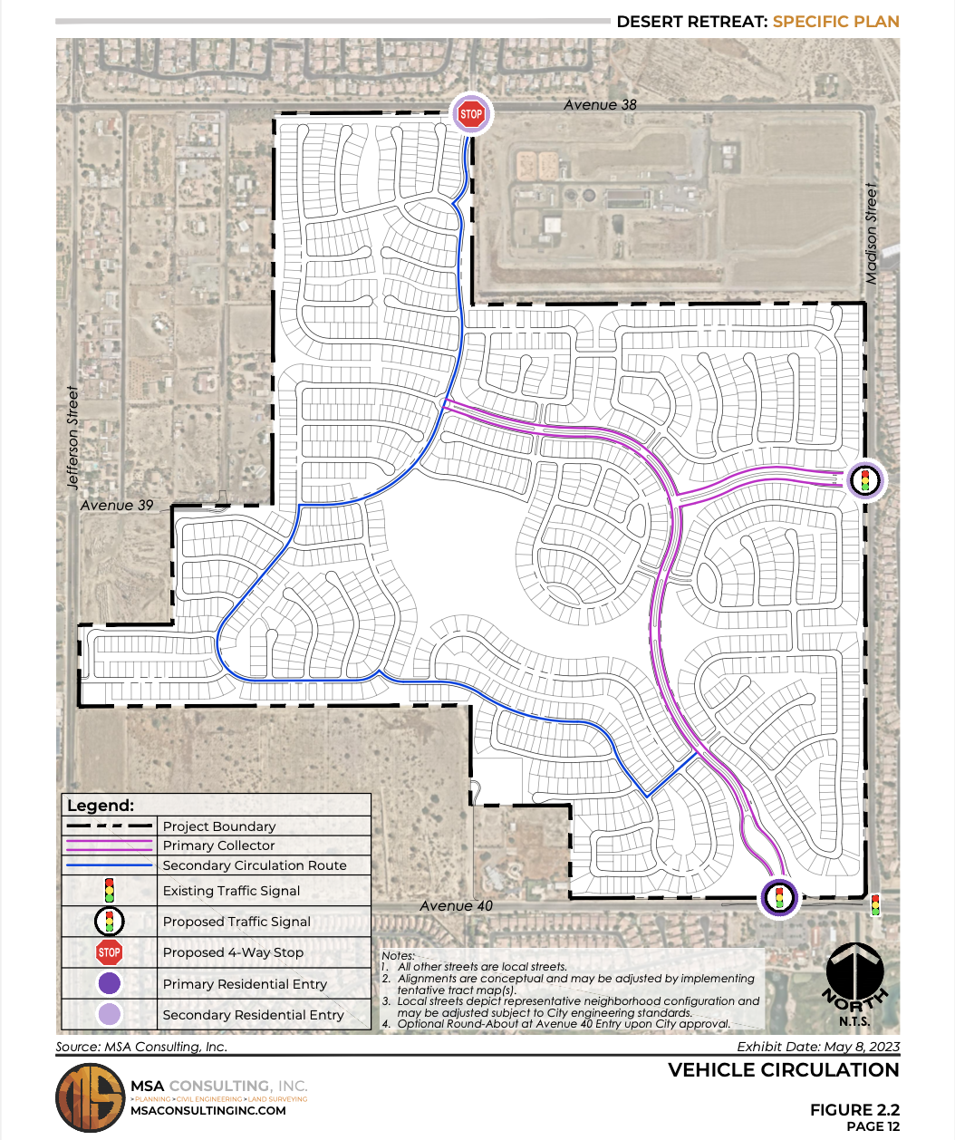
Conceptual
Vehicular
Circulation Plan
The main entrance to Desert Retreat will be on 40th Avenue, with secondary entrances on Madison Street and 38th Avenue.
The main entrance will be a traditional intersection with a traffic signal, crosswalks, and dedicated left turn lanes.

Slide 6
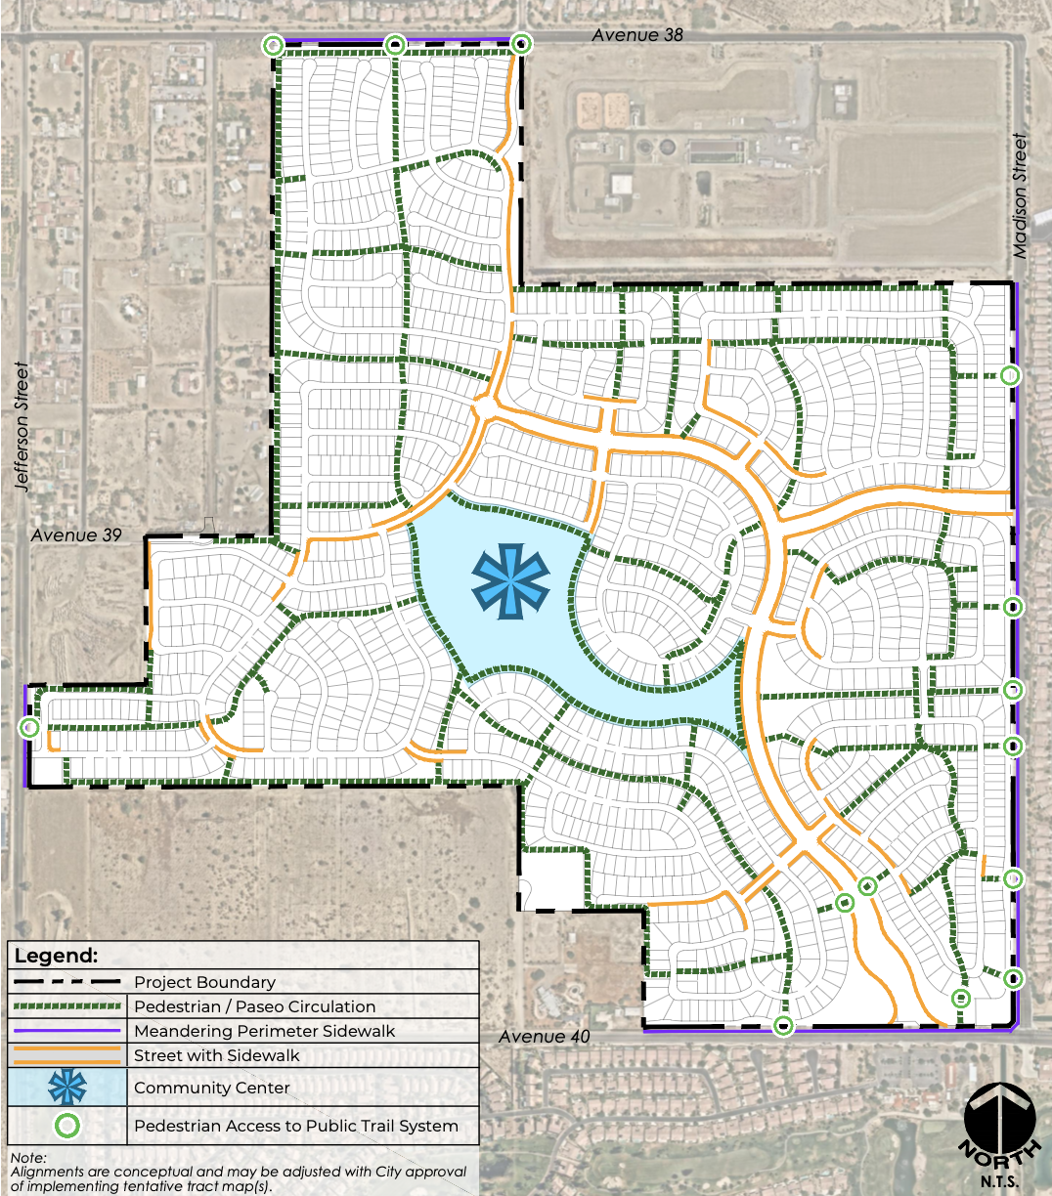
Conceptual
Pedestrian
Circulation Plan
Extensive walking and biking paths with stunning mountain and desert views will surround a resort-style community recreation center. Residents will have pedestrian access to the Public Trail System.

Slide 7
Clubhouse Plan

Slide 8
Clubhouse

Slide 9
Amenities
The master-planned community will feature numerous social, fitness, and recreational activities and programs for project residents.
Extensive walking and biking paths
Resort-style recreation center
Tennis and pickleball courts
Fitness facilities
Community pool
Interior spaces for meetings, classes, and social events

Slide 10
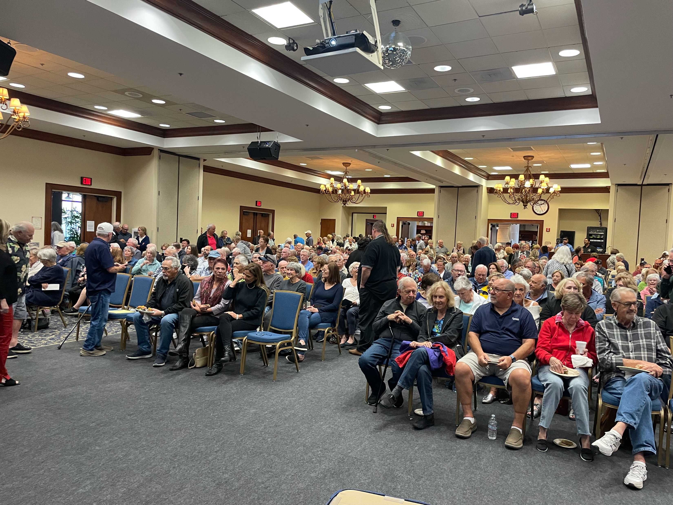
Community
Outreach
July 2022 – Scoping Meeting, Shadow Hills High School
September 2022 – Presentation to Sun City Shadow Hills Board
March 2023 – Presentation to 400+ Sun City Shadow Hills Homeowners
May 2023 - Presentation to Indio property owners within .5 miles of project

Slide 11
What we learned from Community Outreach:
No Roundabout
Based on feedback from Shadow Hills residents and the City’s traffic engineer, the roundabout concept has been removed as a potential design for the project’s main entrance. The proposed design will be a traditional intersection with a traffic signal, crosswalks, and dedicated left turn lanes.

Slide 12
Issues Addressed Based on Community Outreach Meetings:
Main Entrance Location
Traffic experts concluded that the proposed location at the entrance of the Shadow Hills golf course and restaurant provides the safest location for vehicular traffic, pedestrians, and golf carts.
No Vehicle Stacking on Avenue 40
The main entrance guard gate will be located more than 200 feet from Avenue 40 and will have dual lanes with the capacity for stacking at least 40 vehicles.
Widening of Existing Perimeter Roadways
Pulte will widen the entire length of Madison Street (Avenue 38 to Avenue 40) to the designed General Plan buildout of two lanes in each direction. Pulte will also widen Avenue 40, Jefferson Street and Avenue 38 along its project frontages.
Construction Dust and Noise
The Developer will comply with the stringent dust control and air quality requirements of the City and Air Quality Management District.
IID Substation Location
Imperial Irrigation District requires a new substation be constructed to serve the project and it is IID, not the City or Developer, that will ultimately select the substation location.
Sewer Line Expansion in Shadow Hills
Pulte is working with Coachella Valley Water District on an alternative sewer design that avoids impacting the existing Shadow Hills community to install larger sewer lines.
Shadow Hills Homeowner Concerns Regarding Access to Shadow Hills
Pulte/Desert Retreat residents will not have access to the Shadow Hills Clubhouse and private clubs and amenities.

Slide 13
Ongoing Outreach
PulteGroup is committed to transparency and open communication throughout the approval and development process.
Individuals interested in receiving information can sign up to receive project updates at desertretreatindio.com
For more information or inquiries about the community, contact outreach@desertretreatindio.comeach

Slide 14
Anticipated Timeline
Summer
2022
March
2023
June/July
2023
Late
2023
Late
2024
Scoping & Planning
Final EIR & Public Hearings
Draft EIR
Grading Begins
Grand Opening
EIR Scoping Process;
Notice of Preparation
Review Period
Public Scoping Meeting
45 Day Draft EIR
Public Review Comment period
Review Final EIR and Specific Plan by City of Indio Planning Commission and City Council

Slide 15
Contact
For more information and inquiries, email outreach@desertretreatindio.com

